Slide 1
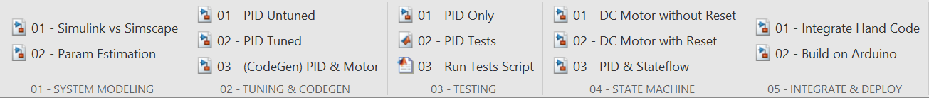
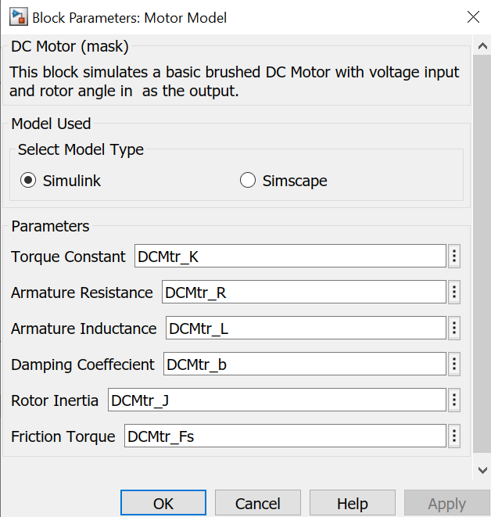
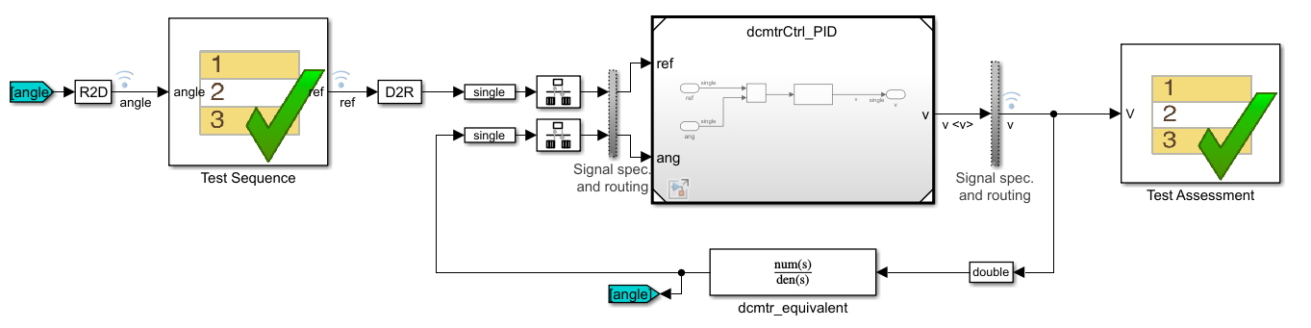
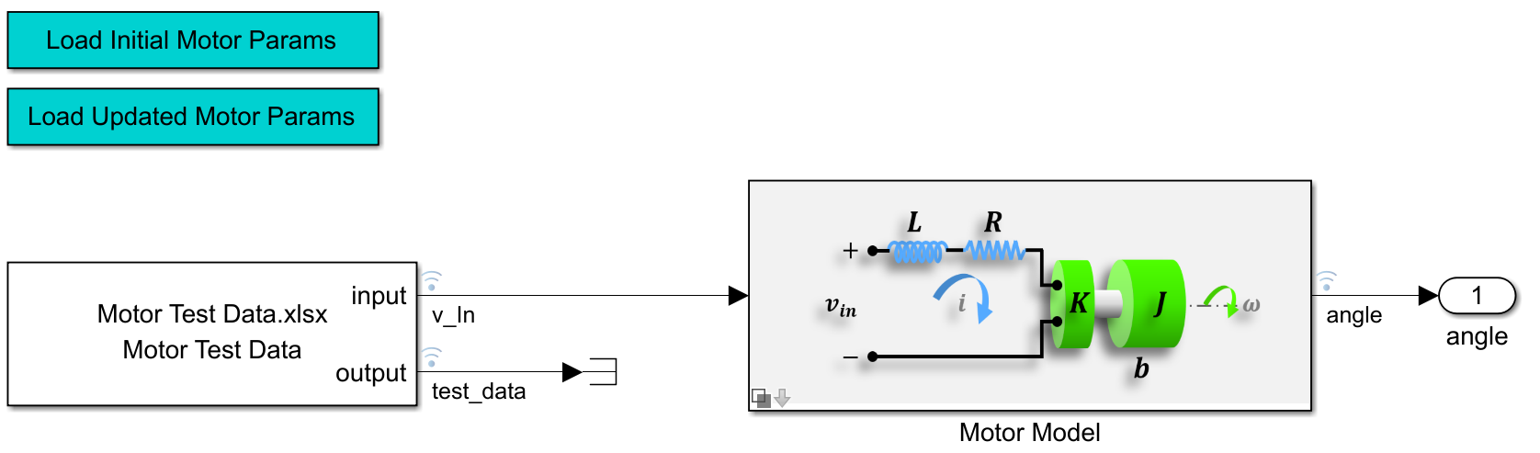
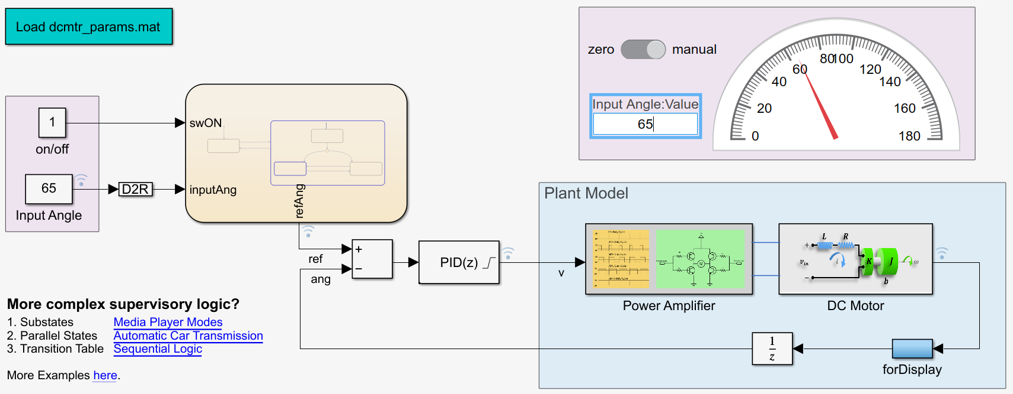
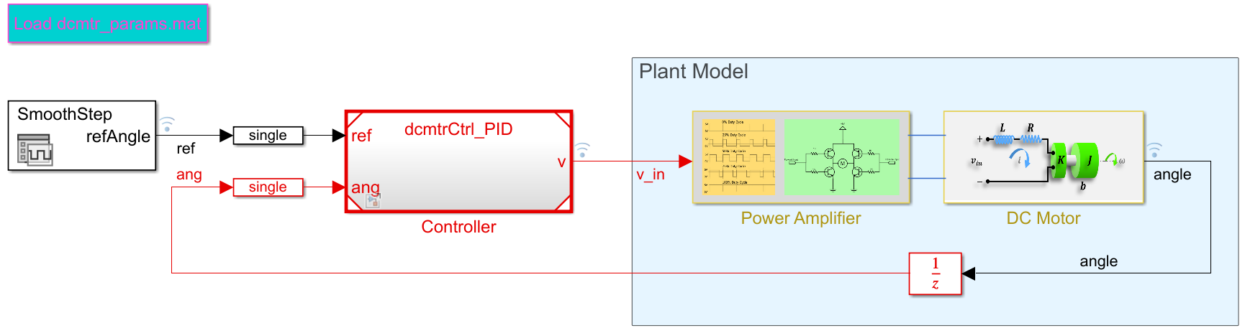
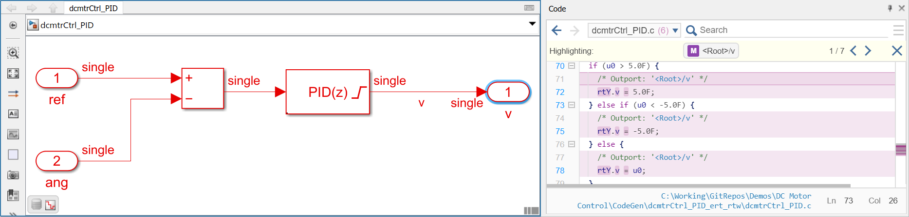
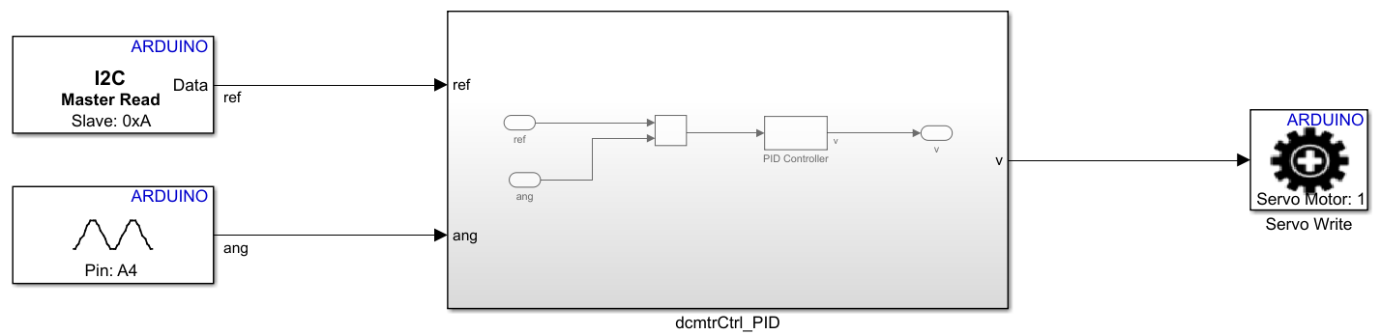
DC Motor Demo for MBD

Slide 3
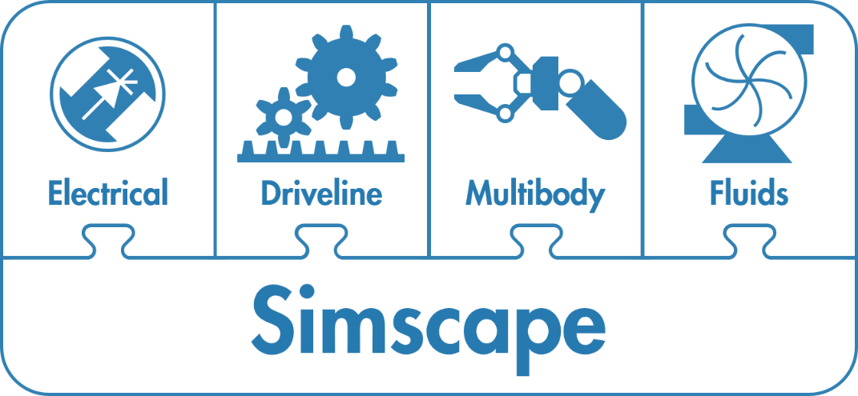
Getting started with Simscape
Notes:
Image Credit: https://www.fluidpowerworld.com/a-review-of-hydraulic-fixed-displacement-pumps/

Slide 4
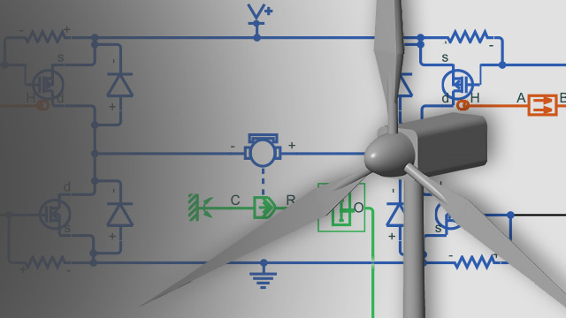
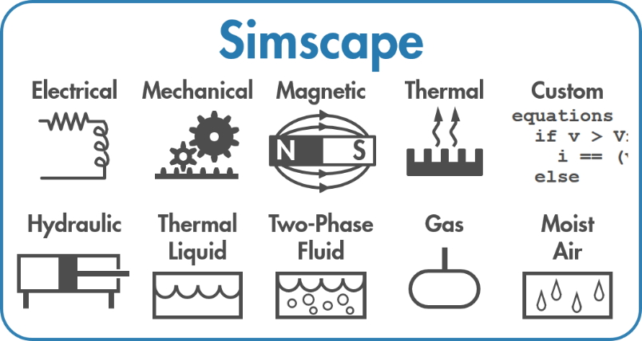
Simscape Family of Products
Simscape platform
Model and simulate real-world physics
Interconnect multiple domains
Reduce the effort it takes to model connected componets

Slide 5
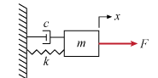
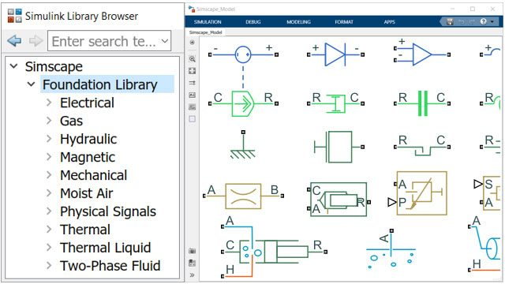
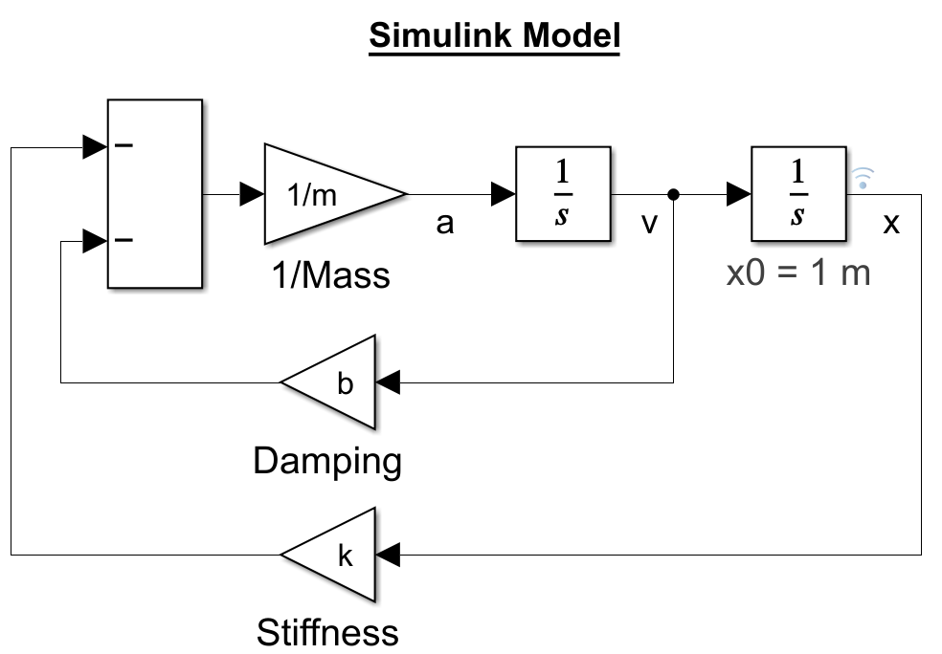
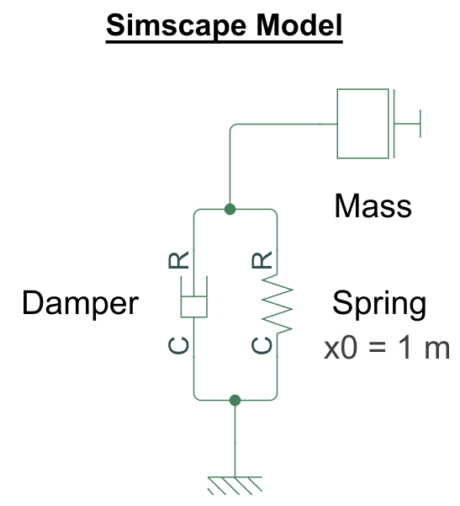
Simscape Family of Products
Modeling in Simscape
Built as physical network using available or custom blocks

Slide 6
Example: Modeling a DC Motor
V+
Friction?
V-

Slide 7
Example: Modeling a DC Motor
V+
Breakaway Friction
(when static)
5V input
V-
Viscous Friction
(when running)

Slide 8
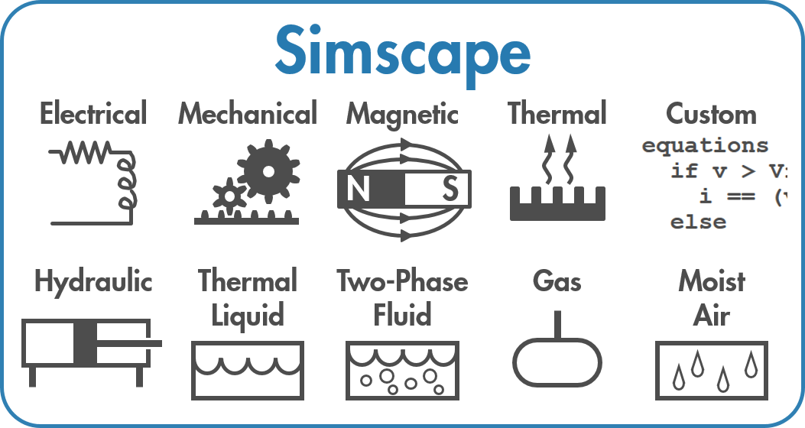
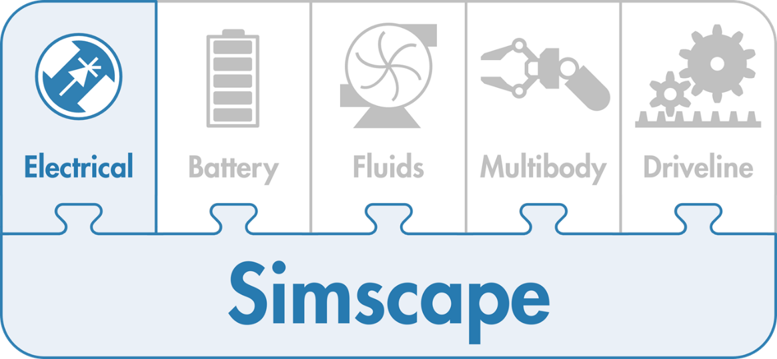
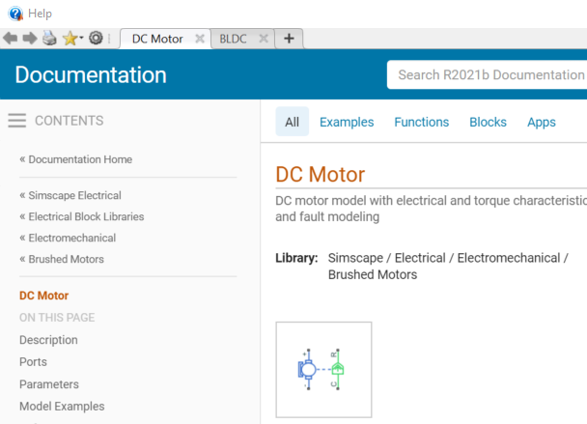
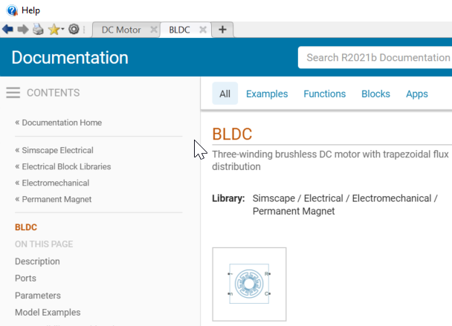
Simscape Products
Enables physical modeling (acausal) of multidomain physical systems
Assemble a schematic
Equations derived automatically
Extend Simscape with domain specifc add-on products

Slide 9
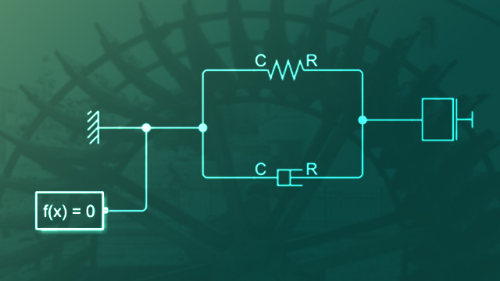
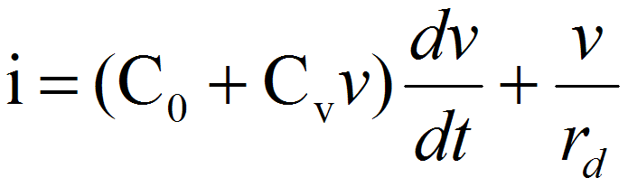
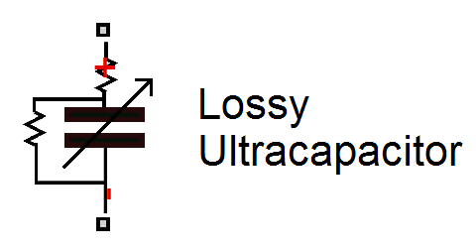
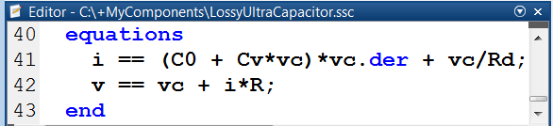
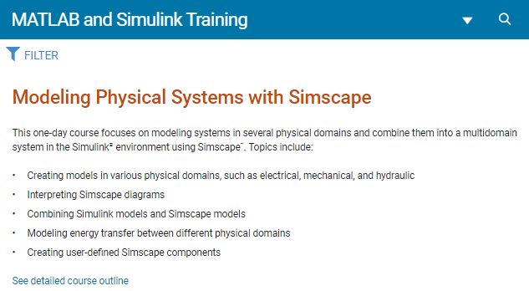
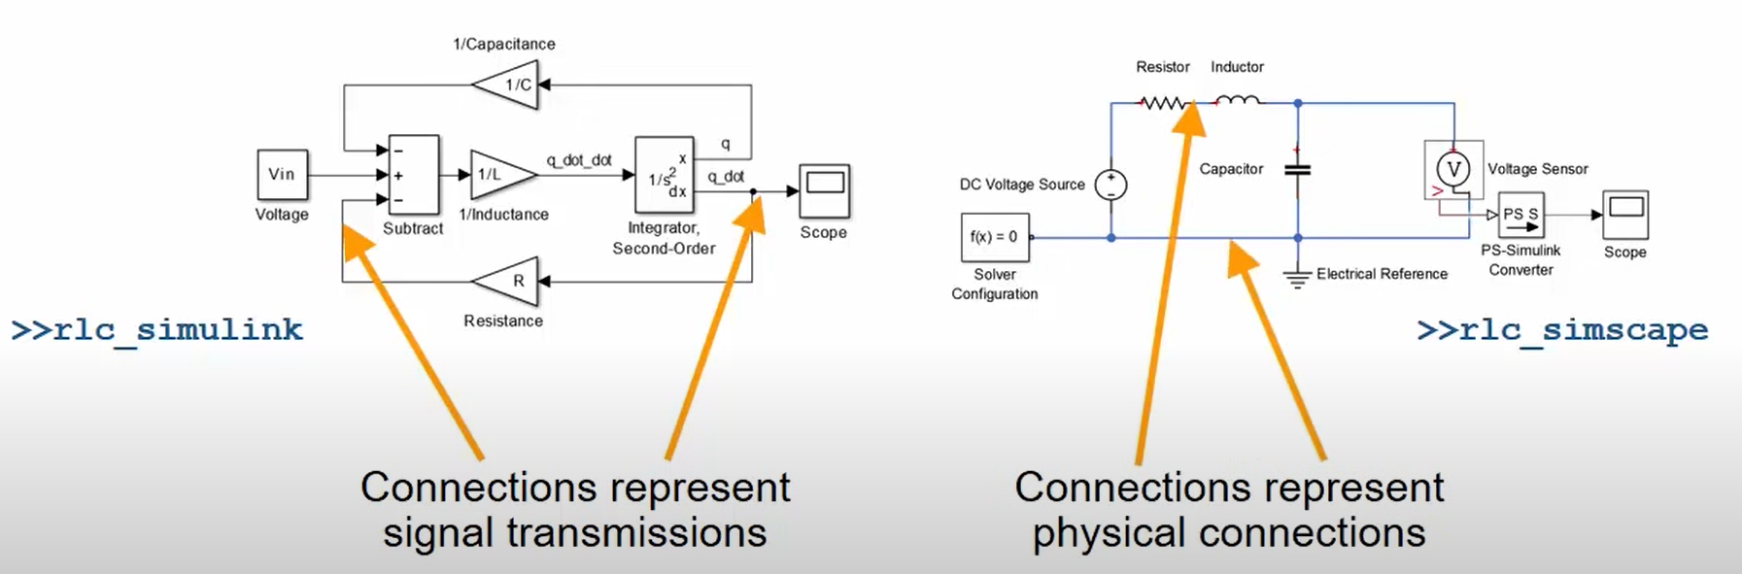
Getting Started with Simscape
Simscape Onramp
Community Resources
Electric Vehicle with Motor Cooling: File Exchange
Develop Custom Simscape Block: Video
Get proficient with Training

Slide 10

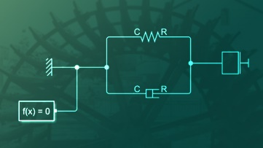
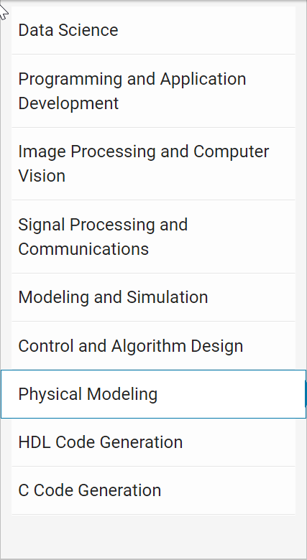
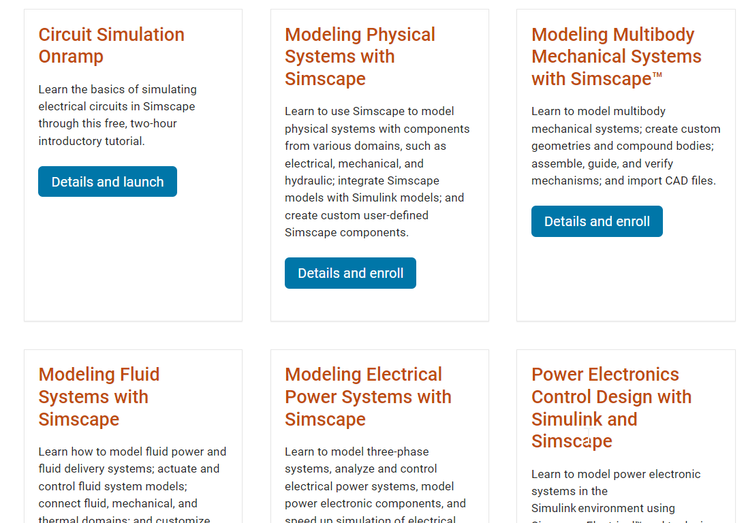



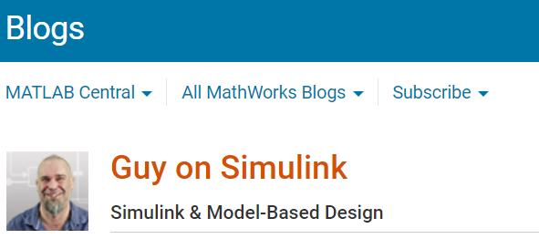
MathWorks Support Mechanisms
Get Started
Get Proficient
Get Accelerated
Guided evaluations with an AE
Onramps, examples and videos
Technical support
Training – Online and in-person
Community – Blogs, File Exchange
Consulting from industry experts
Simscape Onramp
Contact your account managers !

Slide 11
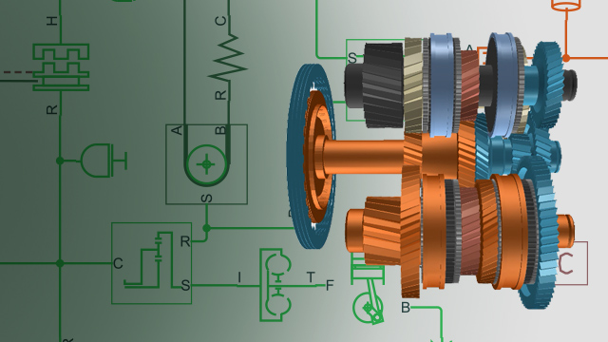


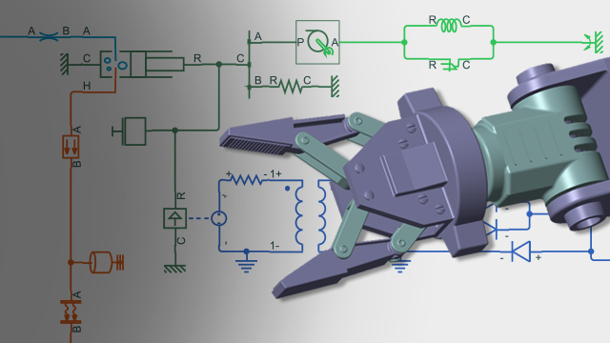
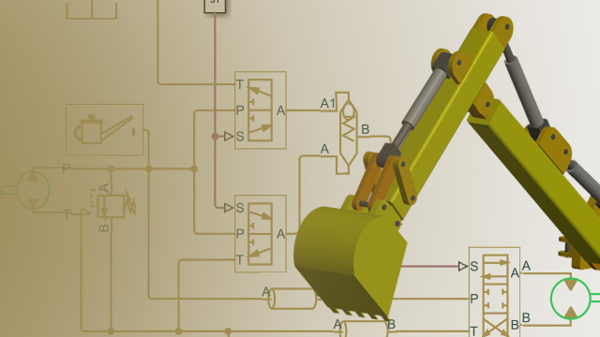
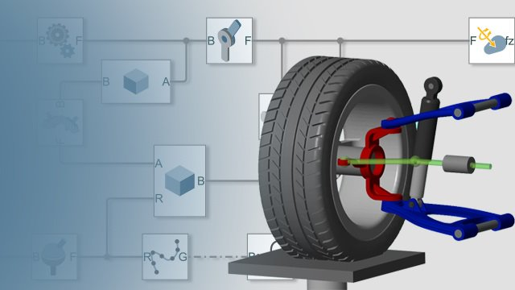



Simscape Products

Slide 12
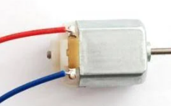
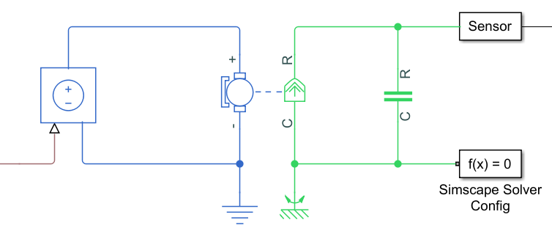
Estimating System Parameters
==
?
Notes:
Image Credit: https://www.fluidpowerworld.com/a-review-of-hydraulic-fixed-displacement-pumps/

Slide 13
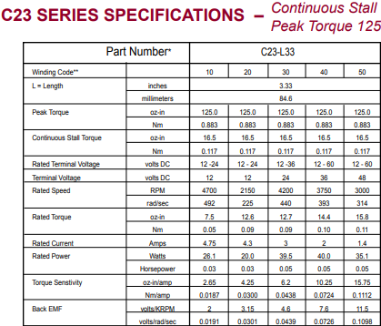
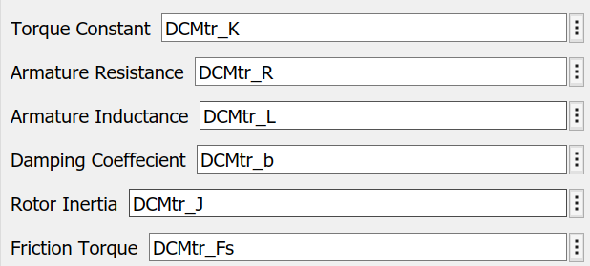
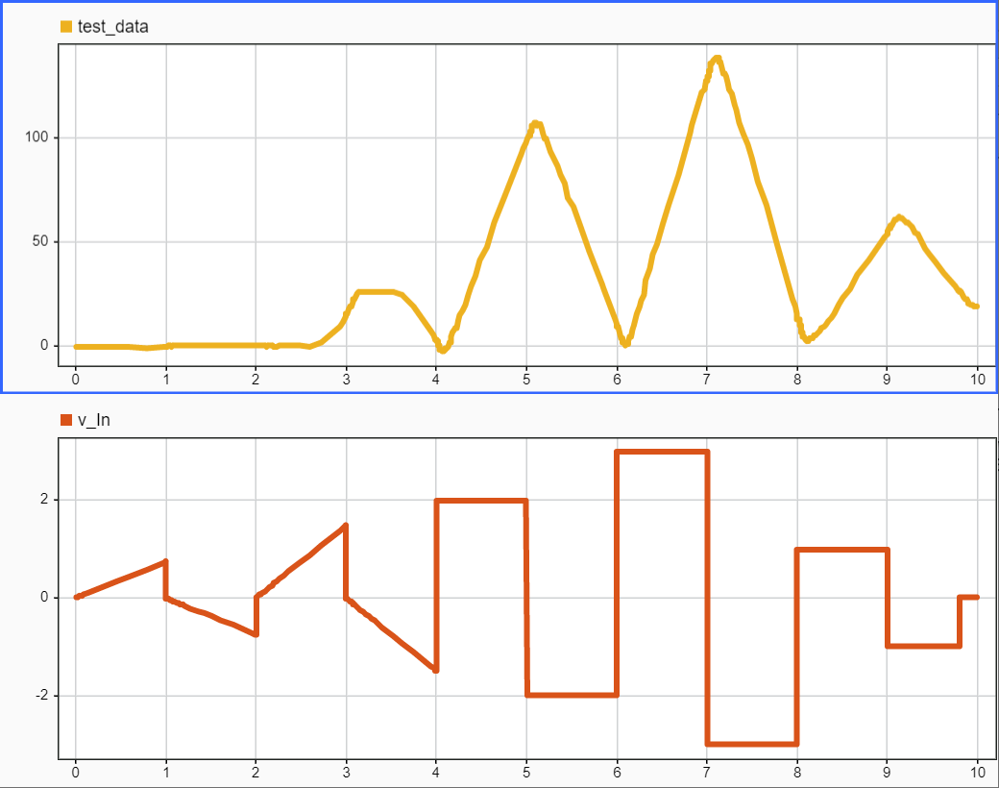
How do you know your model is accurate?
Get the information off a datasheet
Conduct experiments to see what the behavior looks like
Get your model to replicate your test data?

Slide 14
Modeling Physical Systems with MathWorks Products
Modeling Approaches
First Principles Modeling
Data-Driven Modeling
(Simscape Products)
Physical Networks
(Model Based
Calibration Toolbox)
(MATLAB, C)
(Simulink)
(Simscape language)
(Symbolic Math Toolbox)
Statistical Methods
Programming
Block Diagram
Modeling Language
Symbolic Methods
System Identification
(System Identification Toolbox)
(Deep Learning
Toolbox)
Neural Networks
Parameter Tuning
(Simulink Design Optimization)
Learn more here:
https://www.mathworks.com/discovery/parameter-estimation.html
Notes:
There are a wide variety of approaches to modeling physical systems ranging from using the first principles equations to describe the physics to using measured data to generate look-up table models. Each modeling approach has pros/cons. First principle models require knowledge about the physical equations. Creating models from data can be automated, but are generally static models. The MathWorks provides modeling tools across this spectrum. Today we will focus on creating models from first principles.

Slide 15


Scaling up your Simulations Parallel Computing and Cloud Resources for Simulink

Slide 16
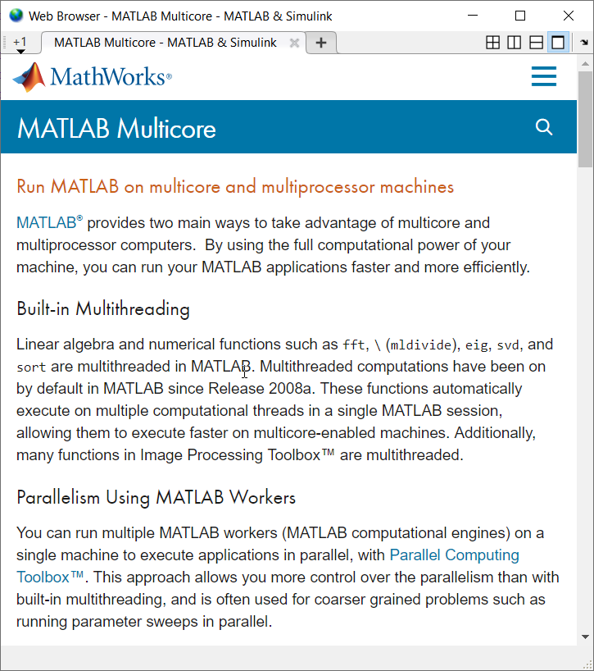



Scale further with parallel computing
Multi-core CPU
MATLAB
Parallel Computing Toolbox
Notes:
Therefore, parallel computing tools enable you to receive benefits beyond these limitations.
Put another way, Parallel Computing Toolbox enables direct control of your parallel resources. For example, parallel constructs like parfor let you control which portions of your workflow are distributed to multiple cores. Later on, we’ll talk about how you can extend that level of control to resources on compute clusters by using MATLAB Parallel Server.
*next*

Slide 17
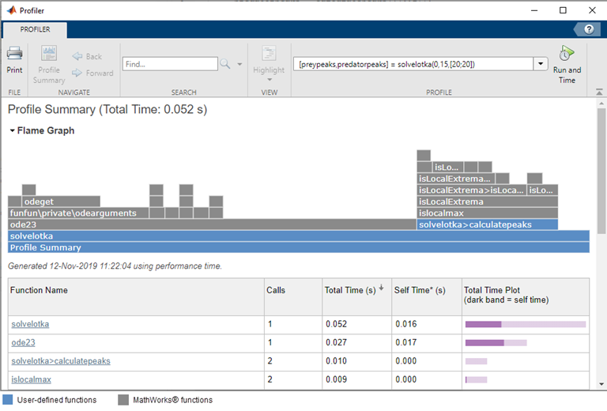
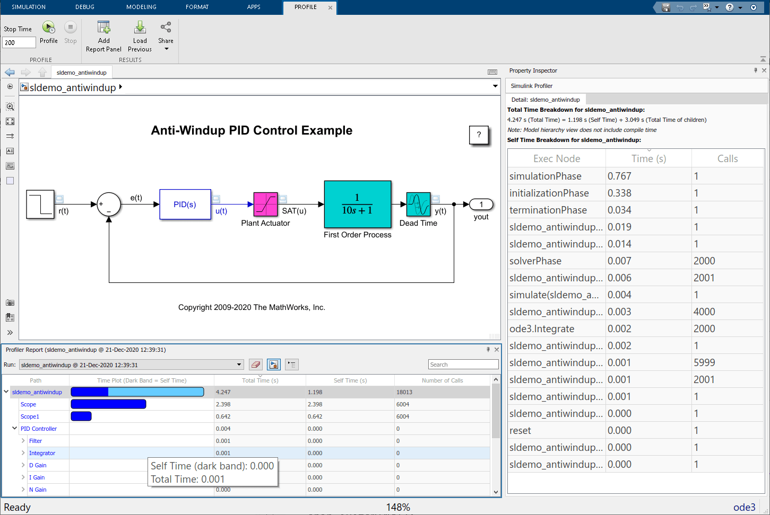
Optimize your code before parallelizing for best performance
Find bottlenecks by profiling your code
Techniques for accelerating MATLAB algorithms
Improving Simulation Performance in Simulink
Notes:
Whether you’re planning to leverage multicore processors, compute clusters, or GPUs, it is important to optimize your code, so that you can receive even better performance improvements when you introduce parallel tools for additional computing power.
Let’s highlight some steps you can take to optimize your code
[click] 1) Before modifying your code, you need to determine where to focus your efforts. Perhaps the most critical tool to support this process is the [click] Profiler, which can help you find bottlenecks by telling you where your code is spending most of its execution time. Improving those areas gives you the biggest performance boosts for your efforts.
[click] 2) Once you’ve located your areas of investment, you can use effective programming techniques like preallocation and vectorization, to accelerate the execution of your MATLAB code. [click] The MATLAB Code Analyzer can help advise you with this, in addition to bringing issues and errors in your code to your attention.
[click] 3) Finally, you may also obtain speedups by replacing parts of your MATLAB code with an [click] automatically-generated MATLAB executable, known as a MEX-function. You can do this using a separate product called MATLAB Coder™
*next*

Slide 18
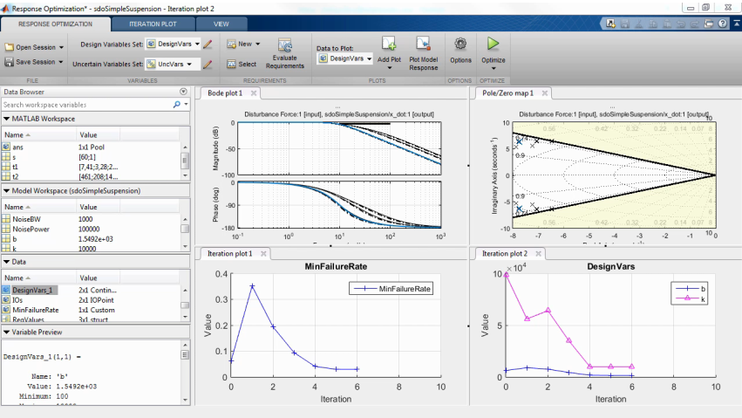
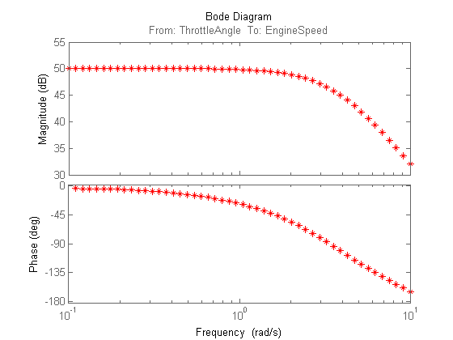
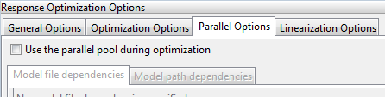
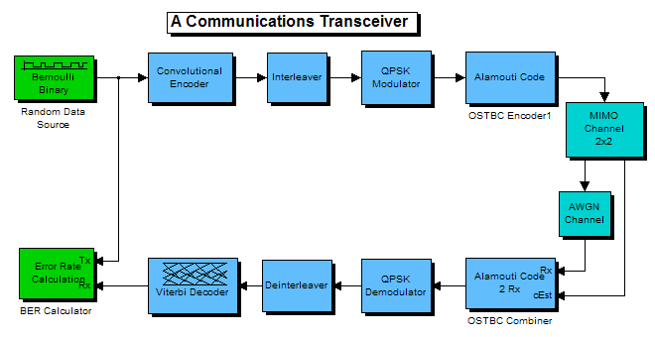
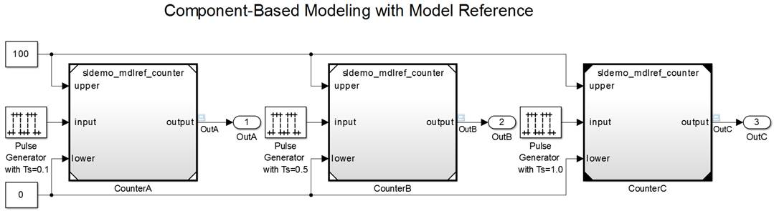
Enable parallel computing support by setting a flag or preference Automatic parallel support (Simulink)
Simulink Design Optimization
Simulink Control Design
Response optimization, sensitivity analysis, parameter estimation
Frequency response estimation
Communication Systems Toolbox
Simulink/Embedded Coder
GPU-based System objects for Simulation Acceleration
Generating and building code
Additional automatic parallel support
Notes:
Similarly, a number of parallel-enabled blocksets and toolboxes for Simulink can help you speed up your workflows with very little effort.
For example - Simulink Design Optimization has one of the best integrations with Parallel Computing Toolbox – [click] you just enable a single checkbox “Use parallel pool during optimization” and it will immediately speed up workflows like sensitivity analysis, response optimization, and parameter estimation.
Once again, you can use the link at the bottom to see the full list of automatic parallel support.
*next*

Slide 19

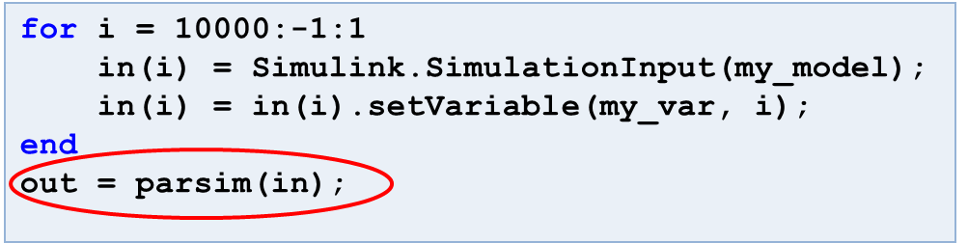
Run multiple Simulink simulations in parallel with parsim
Workers
Time
Time
Run independent Simulink simulations in parallel using the parsim function
Notes:
While you can technically use parfor within Simulink, parfor was designed primarily for MATLAB and is not recommended to be used with Simulink. Instead, use parsim to run multiple simulations in parallel.
parsim distributes multiple simulations to multicore CPUs to speed up overall simulation time. It automates the creation of parallel pools, identifies file dependencies, and manages build artifacts. It also works in conjunction with the new SimulationInput object [I talked with Weiwu about this…”sim-t” is not a thing], which helps you set up all your simulation inputs in a convenient way, including variables, block parameters, and simulation configurations [need a visual for this]
*next*

Slide 20




Benefits of using parsim
Run multiple simulations on your machine or clouds and clusters
Transfer base workspace variables to workers
Automatically transfer all files to workers
Automatically return file logging data
Automatically manage build folders
Display progress
Manage errors
Desktop
Multicore
Cluster

Slide 21
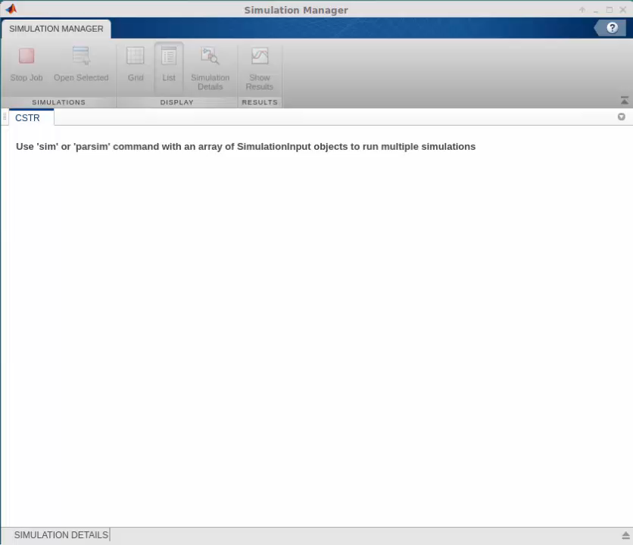
Monitor multiple simulations at once with Simulation Manager
View the progress of the simulations
Examine simulation settings and diagnostics
View simulation results in the Simulation Data Inspector
Notes:
Simulation manager is integrated with parsim and can be used to monitor and visualize multiple simulations in one window.
You can select an individual simulation and view its specifications, as well as use the Simulation Data Inspector to examine simulation results.
You can also conveniently run diagnostic tasks, or abort simulations.

Slide 22

Parallel computing on your desktop, clusters, and clouds
GPU
GPU
Multi-core CPU
Multi-core CPU
MATLAB
MATLAB Parallel Server
Parallel Computing Toolbox
Prototype and develop on the desktop
Integrate with your infrastructure
Access directly through MATLAB
Notes:
Parallel Computing Toolbox and MATLAB Parallel Server allow you to easily extend your execution of MATLAB and Simulink to more resources.
In the parallel computing workflow, you start with MATLAB on the desktop, and incorporate parallel features from Parallel Computing Toolbox to use more resources. In some cases desktop parallel computing will be sufficient for your needs, and in other cases when you need to scale further, your desktop work will serve as a prototype for running on clusters and clouds. (Key features of your prototype will be robustness to being run on a computer that might not have the same file access or operating system as your computer. This type of robustness is often related to hard-coding of paths.)
When you need to scale beyond the desktop, you will need access to a cluster that has MATLAB Parallel Server installed. This might be a cluster managed by your IT department, or it could be a cloud cluster that you set up on your own with Cloud Center or a MathWorks reference architecture.
When you have access to MATLAB Parallel Server, you can use parallel resources on the cluster in the same way you did on the desktop, without needing to re-code your algorithms.

Slide 23


batch simplifies offloading simulations Submit Simulink jobs to the cluster
>> job = batchsim(myCluster,in,'Pool',3)
parsim
MATLAB
Parallel Computing Toolbox
MATLAB Parallel Server
Notes:
For long running jobs, you will want to transition to batch workflows, which we previously mentioned in-passing.
You can send your code using the batch command to run on remote hardware where MATLAB Parallel Server has been installed and configured. Using “batch” offloads work from your computer, so that your machine is no longer tied to the computation. That means you can do something else, put your machine to sleep, or even turn it off. By default, the command will request a single worker for serial computation, but you can include the Pool argument to request multiple workers for parallel computation.
You can submit multiple batch jobs, and the scheduler on the cluster side will schedule work as resources become available. You can check the state and progress of your job with the “State” and “diary” commands, which you can use programmatically -- through the MATLAB command window -- and interactively, through the Job Monitor. After the job has finished, you can retrieve the results in MATLAB, or view artifacts generated from the job on the filesystem of the cluster.
*next*

Slide 24

Transitioning from Desktop to Cloud
Why would you want to use the cloud?
Offload computational load from your working machine
Scale up computing power (RAM, GPU, multi-core CPU, etc.)
On-demand access (“elastic computing”)
Proximity to cloud-based data repository
It’s easy to port your code from desktop to cloud-based workflows
No need to rewrite your algorithm
Supports both Windows and Linux
Learn more:
Parallel Computing Toolbox
MATLAB Parallel Server
Notes:
There could be many reasons for using cloud computing, but some typical ones are:
You don’t want to tie up your local computer
You need special hardware and you only need it once in a while
And sometimes the data you need is already in the cloud
One of the key values MathWorks offers is the ease of transition from desktop to cloud
There’s no need to rewrite your algorithms or worry about whether your OS is supported
Let’s take a brief look at how that’s done

Slide 25









Run MATLAB in the cloud
Virtual Network
Virtual Machine
Run MATLAB in the cloud to access better hardware
Perform data analytics on cloud-stored data
Deploy MATLAB via Azure Marketplace or MathWorks Reference Architecture
Remote Desktop
License Manager
(Hosted by your organization or by MathWorks)
Learn more:
MATLAB on Amazon Web Services (AWS)
MATLAB on Azure
Notes:
If you are limited by your local hardware, you can solve computationally and data intensive problems by running MATLAB in the cloud. You can get access to more cores, more memory, and GPUs. You can try scaling with a cloud virtual machine, to see if a bigger machine is able to scale or speed up your algorithm sufficiently. If a single computer is not enough, MATLAB Parallel Server will be able to help you go beyond a single machine.
This is especially useful if you are working with large data that is stored in the cloud. It helps to have MATLAB located in close proximity to the data for performance and latency reasons.
You can deploy MATLAB in the cloud through the Azure Marketplace, the MathWorks Reference Architecture on GitHub, or through a DIY solution.
You would access MATLAB from your computer with remote desktop, vnc, ssh, or something similar.

Slide 26
Resources
MATLAB Documentation
MATLAB → Advanced Software Development → Performance and Memory
Parallel Computing Toolbox
Parallel and GPU Computing Tutorials
https://www.mathworks.com/videos/series/parallel-and-gpu-computing-tutorials-97719.html
Parallel Computing with MATLAB
https://www.mathworks.com/solutions/parallel-computing.html

Slide 27
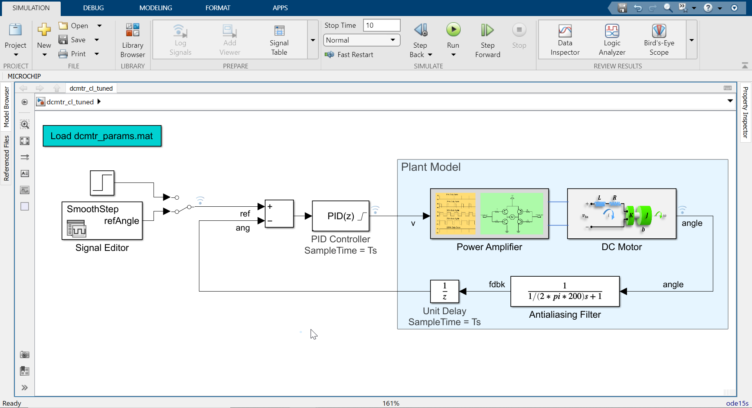
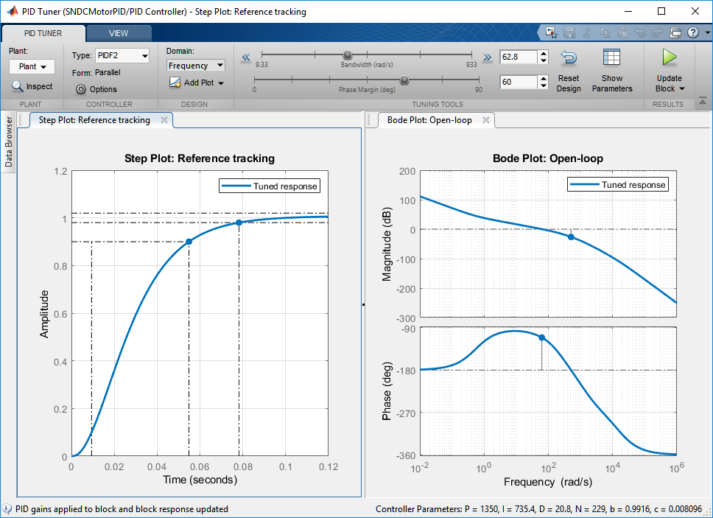
Tuning a PID Controller
Notes:
Image Credit: https://www.fluidpowerworld.com/a-review-of-hydraulic-fixed-displacement-pumps/

Slide 28




What should the PID gains be?
± 5V Limit
Get to a specified angle ASAP
Settling time < 5sec
Minimal overshoot (~10%)

Slide 29









Control Design Typical Workflow Tasks

Slide 30

Is my system replicating real world behavior?
± 5V Limit
Embedded controller will output discrete commands, not continuous
Can I avoid a step input, since that include infinite acceleration and jerk?

Slide 31
Control Design Typical Workflow Tasks
Control System Toolbox
Simulink Control Design
Simulink
Simscape
Simulink Design Optimization
Simulink Control Design

Slide 32



Getting Started with Controller Design
Control Systems Onramp
Not working with a Motor?
Additional tuning challenges: PID Applications
More complex challenges?
MPC, Reinforcement Learning
Get proficient with Training
https://www.mathworks.com/help/control/ug/multi-loop-pid-control-of-a-robot-arm.html

Slide 33
MathWorks Support Mechanisms
Get Started
Get Proficient
Get Accelerated
Guided evaluations with an AE
Onramps, examples and videos
Technical support
Training – Online and in-person
Community – Blogs, File Exchange
Consulting from industry experts
Simscape Onramp
Contact your account managers !

Slide 34


Stateflow for Decision Logic
Notes:
Image Credit: https://www.fluidpowerworld.com/a-review-of-hydraulic-fixed-displacement-pumps/

Slide 35


What is Decision Logic? Supervisory, Fault Management, Task Scheduling
Brake pedal pushed =
cruise control disengaged
Overheating battery shuts off your phone
Gear choice when driving
How does your closed loop react based on external factors?

Slide 36


Why not just use if-else statements?
What’s wrong with this code?
function refAng = mtrCtrlMode(swON, inputAng)
% Specifies if motor stays at zero position or can be commanded
% Function is called every 0.01 seconds
refAng = 0;
persistent tickCount
if isempty(tickCount)
tickCount = 0;
end
if swON == true && tickCount < 300
% motorINITIALIZING
refAng = 0;
tickCount = tickCount +1;
end
if swON == true && tickCount >= 300
% motorCommanded
refAng = inputAng;
tickCount = tickCount +1;
end
function refAng = mtrCtrlMode(swON, inputAng)
% Specifies if motor stays at zero position or can be commanded
% Function is called every 0.01 seconds
refAng = 0;
persistent tickCount
if isempty(tickCount)
tickCount = 0;
end
if swON == true && tickCount < 300
% motorINITIALIZING
refAng = 0;
tickCount = tickCount +1;
end
if swON == true && tickCount >= 300
% motorCommanded
refAng = inputAng;
tickCount = tickCount +1;
end
if swON == false
% motorZERO
refAng = 0;
tickCount = 0;
end
What angle my DC Motor rotates to:
Ref value should be
0 when off
0 when motor initializes (3 secs)
30 after motor initializes
Go back to 0 if initialize is aborted

Slide 37






Code expands, while Stateflow chart remains compact
simple logic
+ hysteresis
+ hysteresis + debouncing

Slide 38


Chart Simulation Semantics Leverage the right modeling technique to describe your behavior
Event Broadcasting
Substates
Parallel States
Transition Junctions
Function Calls

Slide 39


Chart Simulation Semantics Leverage the right modeling technique to describe your behavior
Entry, During, Exit conditions
Substates
Transition Junctions
Parallel States
Event Broadcasting
MATLAB Functions
Simulink Functions

Slide 40







Embedded Coder – Generate C/C++ code optimized for embedded systems
From State Diagrams to Implementation Code
Trace among requirements, model, code, and tests
Streamline code integration with customizable code interfaces and appearances
Deploy and test on supported embedded targets
Notes:
Bring it to the front the model and code mapping and customization, function name and data type
Embedded coder quick start
Code generation advisor
Simulink templates

Slide 41


Verify your decision logic with the help of Simulink Test and Simulink Coverage
Develop, manage and execute tests on models and generated code
Measure test coverage in models and generated code
Technical Article: Continuous Integration for Verification of Simulink Models

Slide 42




Getting Started with Controller Design
Stateflow Onramp
Community Resources
Battery Management System: File Exchange
Finite State Machines: Discovery Page
Get proficient with Training
Video: Getting Started and demo of Parallel States

Slide 43

CodeGen with Embedded Coder
Notes:
Image Credit: https://www.fluidpowerworld.com/a-review-of-hydraulic-fixed-displacement-pumps/

Slide 44








Key Takeaways Leverage Model-Based Design to efficiently develop embeddable algorithms
Explore and Test designs
with Simulink® and MATLAB®
Automate and Review
implementation with Coders
Early-stage validation of concepts = less rework late in the project
Notes:
My goal for today's talk is to highlight the benefits of developing such code using a Model Based approach.
the key idea being when you need to develop something
- explore & debug your design concepts; and test them out using models first
- streamline the process of converting your tested concepts using our CodeGen tools later
So that the C/C++ code you now execute has already gone through early-stage validation
giving you a LOT MORE confidence in how will with work on your system.

Slide 45

Simulink in Application Layer
Application
Algorithm 1
Algorithm 2
Algorithm 3
Middleware
Hardware Abstraction
Scheduler
PLANT MDL

Slide 46



How do I get C code from my model? The Embedded Coder App
Quick Start – generate the first version of your C code
Review code interfaces via report
Code located in the same folder by default
<modelName_ert_rtw>

Slide 47





Account for changing requirements Simulations help assess your change before CodeGen
Add specifications to the interface first
Implement it into the model blocks
Use simulations to assess the changes before you generate code

Slide 48


Streamline code integration Customize code appearance and meet coding standards
Streamline code integration by specifying code mappings
Code advisor checks can update your model settings to generate MISRA compliant code

Slide 49


Does the code match my model behavior? Verify with Software-in-Loop Simulations
core_algorithm.c/.h
Core_algorithm.mex
Core algorithm
Simulation test harness
Normal simulation
Software-in-the-loop
The generated code for the core algorithm matches our simulation behavior

Slide 50
Useful Tips and Tricks
Decide on function and data interfaces early
Use discrete library to represent dynamics
Use model reference to componentize
Use Projects to manage files
Use Quick Start/Code Generation Advisor to prepare model and configuration
Use packNGo to share generated code
Use MATLAB Function block to integrate external C codes
Download support packages to verify and tune on hardware

Slide 51


Getting Started with C Code Generation
Contact your account manager
AE engagement to help guide you
Try the “Getting Started” example
Attend the Embedded Coder Training

Slide 52







Model-Based Design Develop embedded code to meet industry compliant standards
AUTOSAR
ISO 26262
DO-178 (Level A)
RESEARCH
REQUIREMENTS
DESIGN
Environment Models
Physical Components
BWM Germany
Automated Driving
TRW Germany
Electronic parking brake
Honeywell Aerospace USA
Flight Control Systems
Algorithms
TEST AND VERIFICATION
IEC 62304
IEC 61508
EN 50128
IMPLEMENTATION
C, C++
VHDL, Verilog
Structured Text
MCU
DSP
FPGA
ASIC
PLC
INTEGRATION
Weinmann Medical Germany,
Transport ventilator
Alstom Grid UK
HDVC Power Systems
Alstom France
Train Control Systems
Notes:
52

Slide 53


Systematic and Automated Testing
Simulink Test
Develop, Manage and execute simulation-based events
Notes:
Image Credit: https://www.fluidpowerworld.com/a-review-of-hydraulic-fixed-displacement-pumps/

Slide 54


Build your Tests
Is it functioning correctly?
Is the code identical to the model?
Simulink Models
Requirements
Design
Model
Model used for production code generation
C/C++/HDL
Generated code

Slide 55










Build your Tests Simulink Test features to author and manage tests
Test Manager
Test Harnesses
Test Authoring
Author, manage, organize tests
Execute simulation, equivalence and baseline tests
Review, export, report
Isolate Component Under Test
Synchronized, simulation test environment
Specify test inputs, expected outputs, and tolerances
Construct complex test sequences and assessments
Main Model
Component under test
Test Browser
Test Sequence
Signal Editor
Test Results
Reports
Test Harness
Time-Series Data
Temporal Assessments
Notes:
Simulink Test provides three main capabilities for testing models: -
a test manager for organizing, executing and reporting tests and test results.
<click> test harnesses for isolating a component under test and toseparate your test artifacts from your design artifacts.
<click> And multiple test authoring options
In the functional testing process test-cases are authored by reviewing the requirements document
You can use Test Sequence and Test Assessment blocks to create complex test scenarios as well as pass/fail conditions.
For more flexibility in creating tests, you can capture test input in an Excel template and define baseline results using Excel

Slide 56

Build your Tests Different test cases based on assessment needs

Slide 57
Build your Tests Equivalence test between MiL and SiL
core_algorithm.c/.h
Core_algorithm.mex
Core algorithm
Simulation test harness
Normal simulation
Software-in-the-loop
The generated code for the core algorithm matches our simulation behavior

Slide 58






Build your Tests
Test Case
Model Sim through SIL, PIL and HIL
Scale with PCT and CI
Inputs
Assessments
MAT file (input)
MAT file (baseline)
Signal Editor
Test Harness
MATLAB Unit Test
Test Sequence
Assessments
Excel file (input)
Excel file (baseline)
and more!
Main Model
and more!

Slide 59


Build your Tests Additional Features to help you test: Temporal Assessments
Temporal Assessment Editor
Activate Heat Pump
If the temperature difference exceeds 2 degrees for more than 2 seconds, then the pump shall activate for at least 2 seconds
Formalize and
execute
Notes:
Since Release 2019a you can create temporal assessments using the new Logical and Temporal Assessments editor in the Test Manager.
The editor helps you translate your textual requirements into unambiguous assessments with clear, well-defined semantics.

Slide 60


Build your Tests Additional Features to help you test: Observers
Access nested signals without signal lines or changing dynamic response
Avoid modifying interface for testing
Simplify design and test by avoiding additional signal lines
Design Model
Notes:
With Observers, you can separate verification logic from the design and access any signal, at any hierarchy, without modifying the interfaces and without impacting the systems dynamic response.
It helps to avoid cluttering the model with additional signals required only for testing
The verification logic can be located in a separate model the co simulates with the model

Slide 61


Build your Tests Additional Features to help you test: Observers
Access nested signals without signal lines or changing dynamic response
Avoid modifying interface for testing
Simplify design and test by avoiding additional signal lines
Design Model
Observer Model
Watch this Overview Video
Notes:
With Observers, you can separate verification logic from the design and access any signal, at any hierarchy, without modifying the interfaces and without impacting the systems dynamic response.
It helps to avoid cluttering the model with additional signals required only for testing
The verification logic can be located in a separate model the co simulates with the model

Slide 62



Automate your Tests
“sltest” APIs and “-batch” commands
Interactively build/review tests with Simulink Test
Automate tests using sltest APIs
Call MATLAB executable directly
Manage project with Source Control
Set MATLAB up on CI platform
Article: Continuous Integration with Simulink Project and Simulink Test

Slide 63






Automate your Tests
Setting up MATLAB on your CI Platform? Contact us!
MATLAB Plugin for Jenkins
Run tests
Publish outputs automatically
Prebuilt Examples
Doc: MATLAB support on different CI Platforms

Slide 64

A123 User Story: Continuous Integration within a Model Based Workflow
Challenge
As the team expanded, it was getting difficult to ensure the everyone was testing in a consistent manner.
Solution
A123 integrated Model-Based Design with Jenkins for continuous integration.
Results
Resulting environment automates 90% of the steps along the common software development process
Facilitates design reviews that are based on a rich set of data and metrics
Click here to watch the video

Slide 65




Where to go next? Learn more from the following pages/examples
Download and compelte example
Requirements-based Testing
Article detailing out a CI setup
Continuous Integration of Models
Visit the Solution Pages:
Continuous Integration
Verification and Validation
Work together with us
Request for an AE engagement
Jumpstart your VnV with our consulting options [1][2]

Slide 66








MathWorks Support Mechanisms
Get Started
Get Advanced
Get Accelerated
Guided evaluations with an AE
Technical support
Onramps, examples and videos
Training – Online and in-person
Community – Articles, File Exchange
Work with industry experts in MBD
Avoid common pitfalls that delay certification
Contact your account managers !

